Slide 1

Vehicle Health Analysis and Spare Parts E-Commerce
SRM INSTITUTE OF SCIENCE AND TECHNOLOGY
SCHOOL OF COMPUTING
DEPARTMENT OF DATA SCIENCE AND BUSINESS SYSTEMS
18CSP109L - MAJOR PROJECT
Student 1 Reg. No: RA1911027010058
Student 1 Name: YUVRAJ SINGH CHAUHAN
Student 2 Reg. No: RA1911027010007
Student 2 Name: AVINASH REDDY VASIPALLI
Guide name: T. KARTHICK
Designation: Assistant Professor Department: DSBS

Slide 2
Table of Contents
Abstract
Introduction
Motivation
Literature Survey
Problems with Existing Systems
Objectives
Innovation in project
Proposed System
Architecture
Proposed Modules and their Algorithm Description
UML Diagrams
Testing /Initial Result Analysis

Slide 3
Abstract
The automotive industry has witnessed a surge in the use of technology to improve efficiency and accuracy in various aspects of vehicle maintenance.
The "Vehicle Health Analysis and Spare Parts E-Commerce" web application aims to simplify vehicle maintenance and repair for vehicle owners, insurance companies, and spare parts businesses.
The application utilizes Python and Streamlit for vehicle health analysis and PHP and MySQL for its spare parts E-commerce component. .
In addition, the spare parts E-commerce component enables users to purchase genuine spare parts for their vehicles directly from the manufacturer.

Slide 4
Introduction
Vehicle maintenance and repair can be a complex and time-consuming task for vehicle owners. This is particularly true when it comes to estimating the insurance amount for a vehicle and finding the right spare parts.
For this advanced machine learning algorithms is used to predict the insurance amount for a vehicle based on a range of factors, such as manufacture, model, year, engine type, and accident history.
In addition, the website provides relevant spare parts recommendations based. This makes it easier for vehicle owners to make informed decisions about their vehicle's maintenance and repair.
For spare parts businesses, it provides a new channel for reaching customers and promoting their products, increasing sales and customer loyalty.

Slide 5
Motivation
The "VEHICLE HEALTH ANALYSIS AND SPARE PARTS E-COMMERCE" website is motivated by the need to provide an all-in-one solution for vehicle owners, to help them maintain get best insurance coverage for their vehicles and purchase genuine spare parts.
In many cases, vehicle owners may only become aware of a problem after it has become a more significant and costly issue for which they are not paid their full insurance amount.
By data analysis, the website can help vehicle owners to get their maximum insurance amount as possible and to prevent costly repairs and breakdowns.
By providing a secure and convenient platform for the purchase of genuine spare parts, the website can save vehicle owners time and effort, and give them peace of mind that they are using quality parts to maintain their vehicle.

Slide 6
Literature Review
Title | Methodology | Observation
Vehicle Health Monitoring and Analysis May 2016, Parmesh K. R | Modern vehicles are integrated with more number of ECUs and sensors which make them smarter in terms of engine decisions, performance, fuel efficiency, security and stability. | ECUs provides useful data in the form of diagnostic codes via OBDII (on-board diagnostics) protocol, these codes determine a specific issue in the vehicular system which is used by service technicians to address the issues occurred.
A Vehicle Health Monitoring System Evaluated Experimentally on a Passenger Vehicle October 2006, Hok K. Ng, Robert H. Chen, Jason Speyer | A residual generator and a residual processor are designed together to detect and identify actuator and sensor faults of the Buick LeSabre rapidly. The residual generator includes fault detection filters and parity equations. | A real intermittent sensor fault occurred and was immediately detected and identified. The real-time evaluation demonstrates that the vehicle health monitoring system can detect and identify actuator and sensor faults under various disturbances and uncertainties with almost minimal detection latency.

Slide 7
Title | Methodology | Observation
Automotive vehicle Health Monitoring and Damage Detection System February 2022, Shankar D. Birajdar, Atul R. Saraf, Nilesh G Patil | A damage detector is affixed to a surface of a material for detecting a damage or crack inside the material or vehicle body. In response to detecting a damage, a damage indicator is generated, A microstrip antenna /nanostrip antenna communicates the damage indicator to an external device. | The microstrip antenna detects the damage and the time when the damage was detected. Additionally, the antenna may associate other information with the damage indicator such as temperature and acceleration information.
Demand Forecasting for Motor Vehicle Spare Parts January 2012, J. J. Strasheim | A variety of alternative forecasting techniques were evaluated for this purpose with the aim of selecting one optimal technique to be implemented in an automatic reordering module of a real time computerized inventory management system. | Vehicle spare parts selected the optimal technique to forecast vehicle parts for the upcoming future so that the stock for those parts can be replenished.

Slide 8
Problems in Existing Systems
Limited Data Availability: The accuracy of the vehicle health analysis and insurance prediction relies on the data that is available. If the is no data, then the analysis and predictions is impossible.
Reliance on Sensors: The vehicle health analysis component relies on sensors in the vehicle to collect data
Limited Scope: The website's analysis and recommendations are limited to the information provided by the sensors and the algorithms used. There may be other factors that are not considered that could impact the health of the vehicle.
Halt of Spare Parts Production: If the vehicle is of very old model or doesn't have that many sales, the manufacturer may completely halt the manufacturing of that particular vehicle model's spare parts.

Slide 9
Objectives
Insurance Prediction: The website uses machine learning algorithms to predict the insurance amount, and to prevent costly repairs and breakdowns.
Spare Parts E-commerce: The website provides a secure and convenient platform for the purchase of genuine spare parts.
Performance and Reliability: The website aims to provide high performance and reliability, ensuring that users can access and use the website without any downtime or technical issues.
Security: The website aims to provide a secure platform for transactions and user data, protecting users from any potential security risks.

Slide 10
Innovation in Project
The innovation idea behind the website lies in its combination of machine learning algorithms, E-commerce, and a user-friendly interface to provide an all-in-one solution for vehicle owners.
Moreover, the use of machine learning algorithms for vehicle health analysis and insurance prediction is an innovative approach that provides users with intelligent recommendations for maintenance and repairs.
It can help vehicle owners to get the best possible insurance amount for their vehicles, prevent costly repairs and breakdowns, and save time and money in the long run.
Additionally, the use of a secure and convenient E-commerce platform for the purchase of genuine spare parts is another innovative feature of the website.

Slide 11
Proposed System
The machine learning algorithms used by the website can help vehicle owners to get the highest insurance coverage for their vehicle and.
The insurance prediction feature of the website can also be beneficial for vehicle owners, as it can provide an estimate of their insurance costs based on the analysis of their vehicle's health and driving patterns.
The spare parts E-commerce component of the website provides a secure and convenient platform for the purchase of genuine spare parts, which can be used by individual vehicle owners, mechanics, and fleet managers.

Slide 12
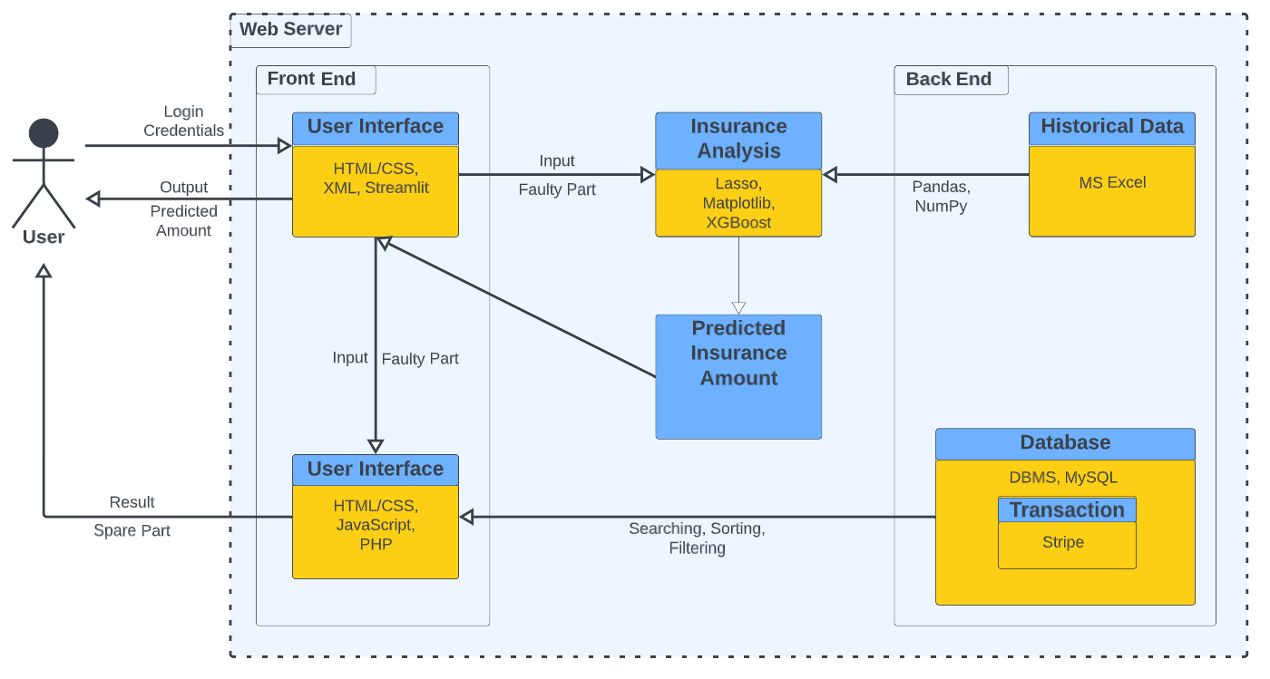
Architecture Diagram

Slide 13
Proposed Modules and their Algorithm Description
The vehicle health analysis component, the website is built using Python and the Streamlit framework. The following are some of the modules and algorithms used in this component:
Pandas - for data manipulation and analysis
NumPy - for numerical computation
Scikit-learn - for machine learning algorithms such as regression, classification, and clustering
Matplotlib - for data visualization
The vehicle health analysis component uses machine learning algorithms to predict premium and price of vehicle this is trained on historical data.

Slide 14
For the spare parts E-commerce component, the website is built using PHP and the MySQL database management system. The following are some of the modules and algorithms used in this component:
HTML/CSS - for website design and layout
JavaScript - for front-end functionality
PHP - for server-side scripting
Xampp Server – Host the website
MySQL - for database management and storage
Stripe - for secure online payments

Slide 15
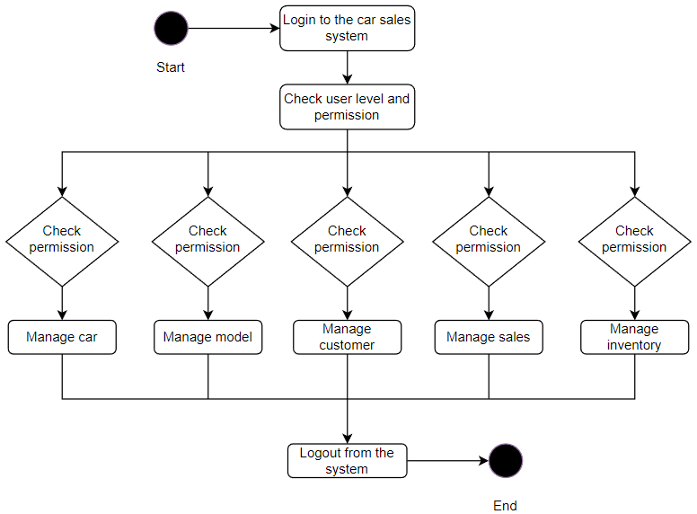
UML Diagrams
Activity Diagram

Slide 16
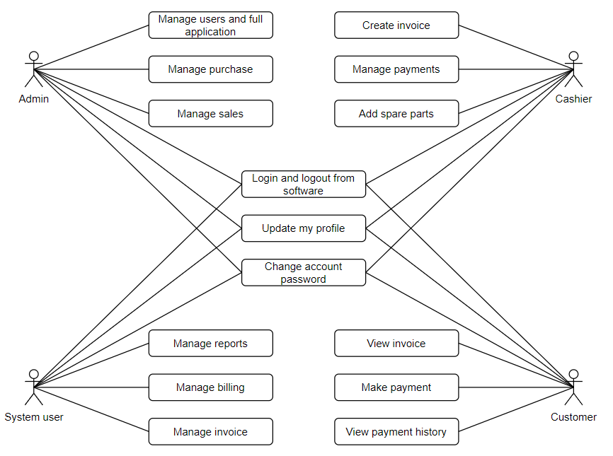
Use Case Diagram

Slide 17
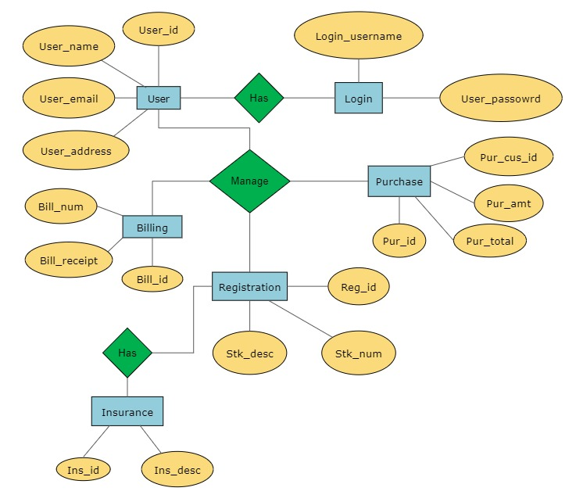
ER Diagram

Slide 18
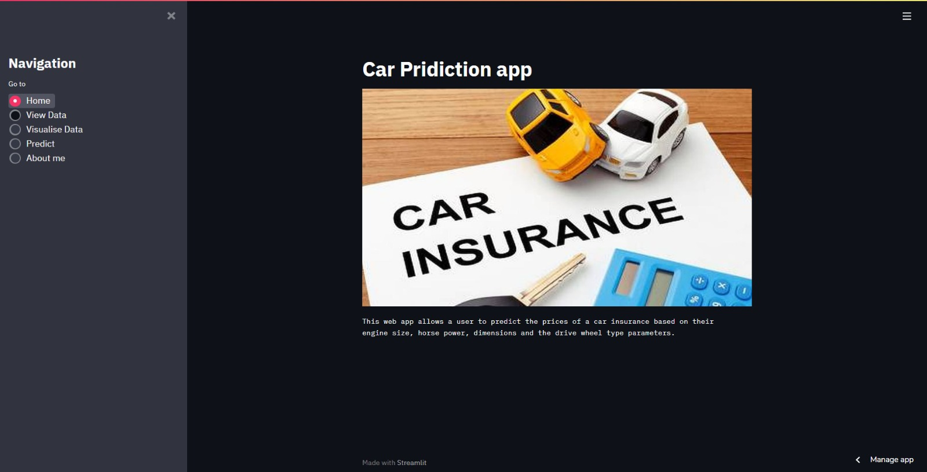
Testing /Initial Result
Home Page

Slide 19
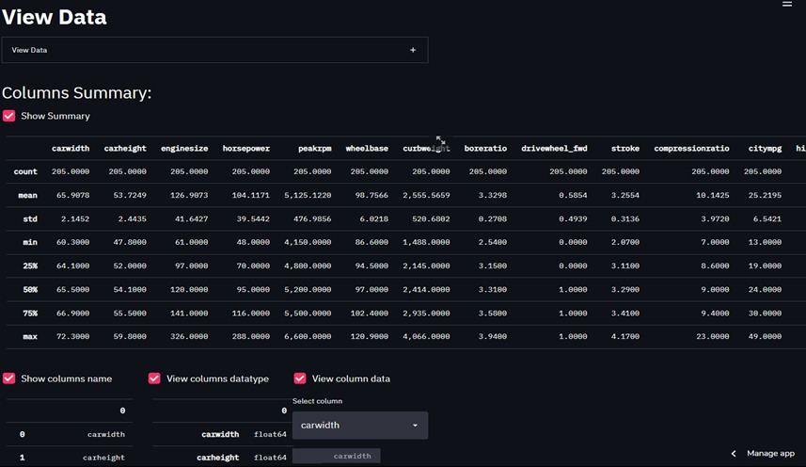
Database

Slide 20
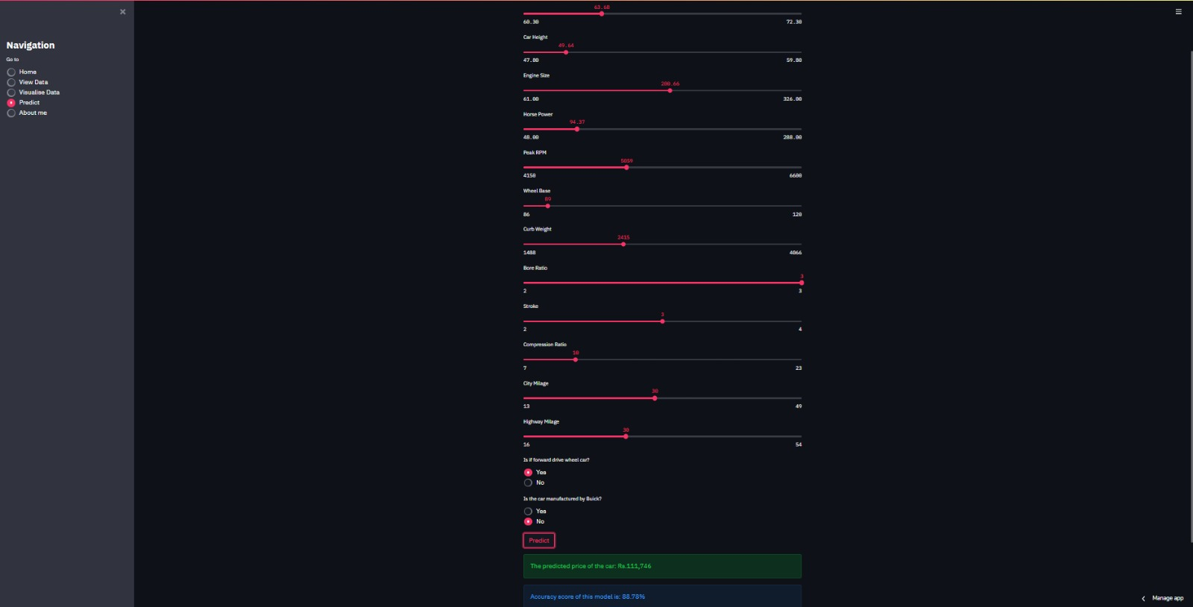
Prediction

Slide 21
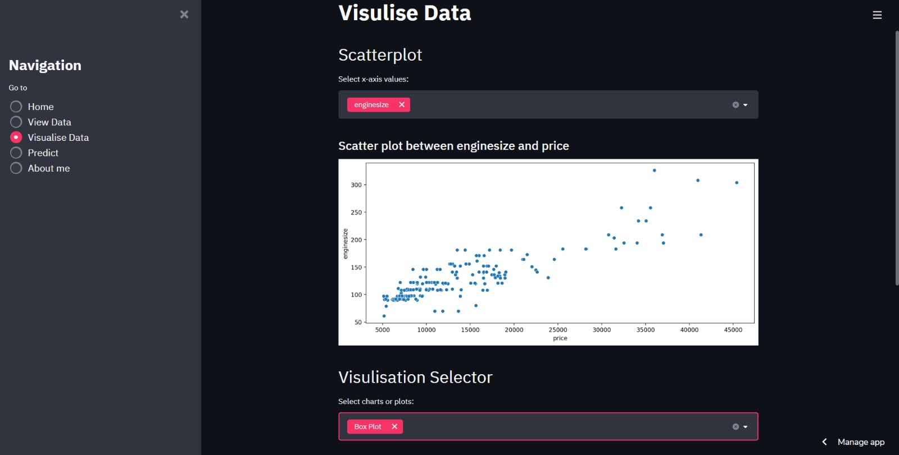
Visualization data

Slide 22

Home Page

Slide 23
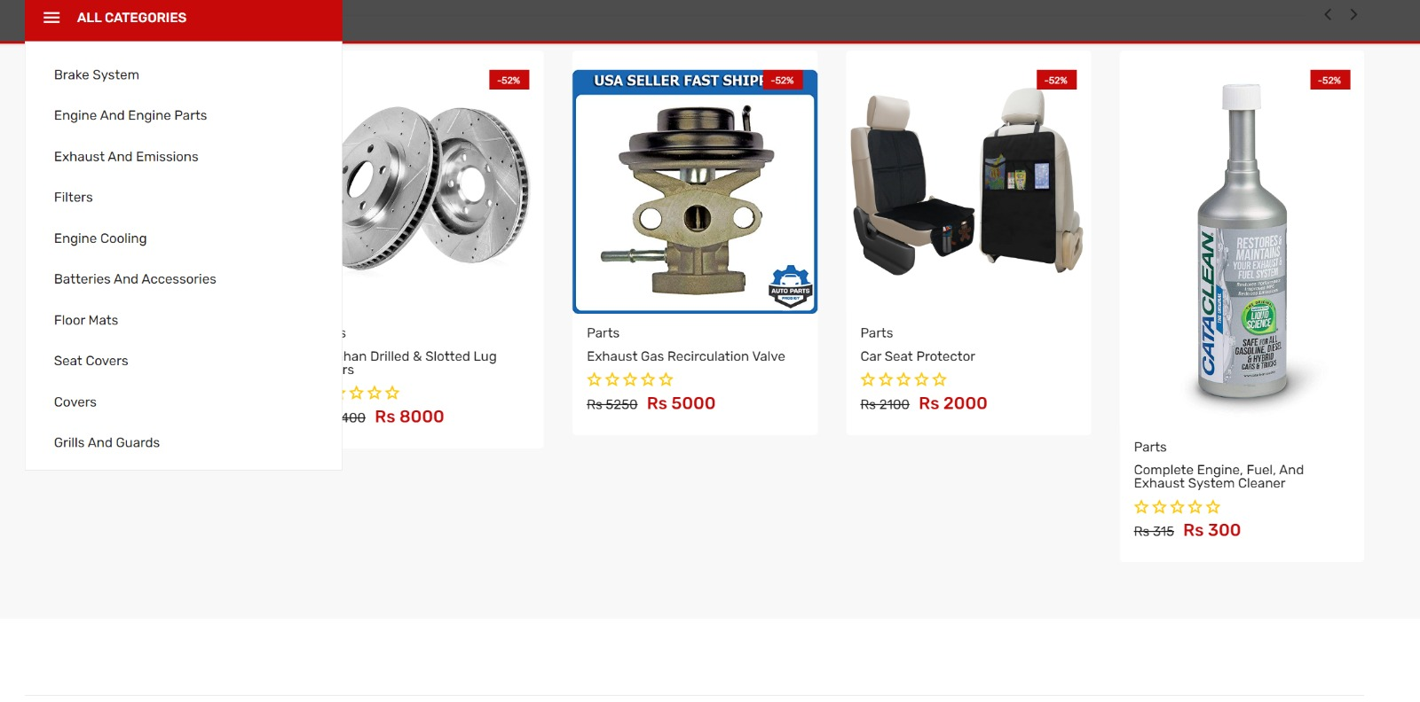
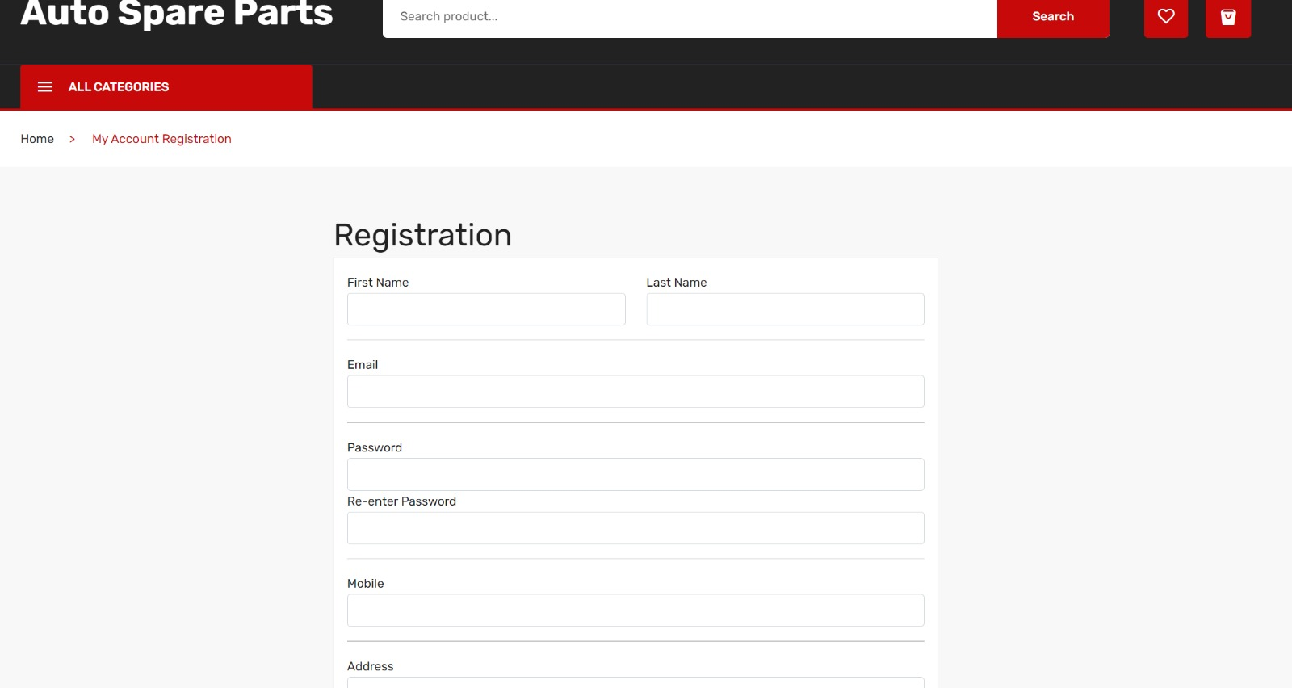
Product Categories
Registration Page

Slide 24
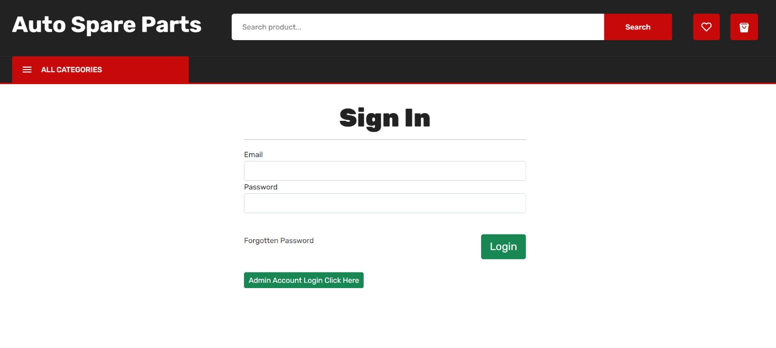
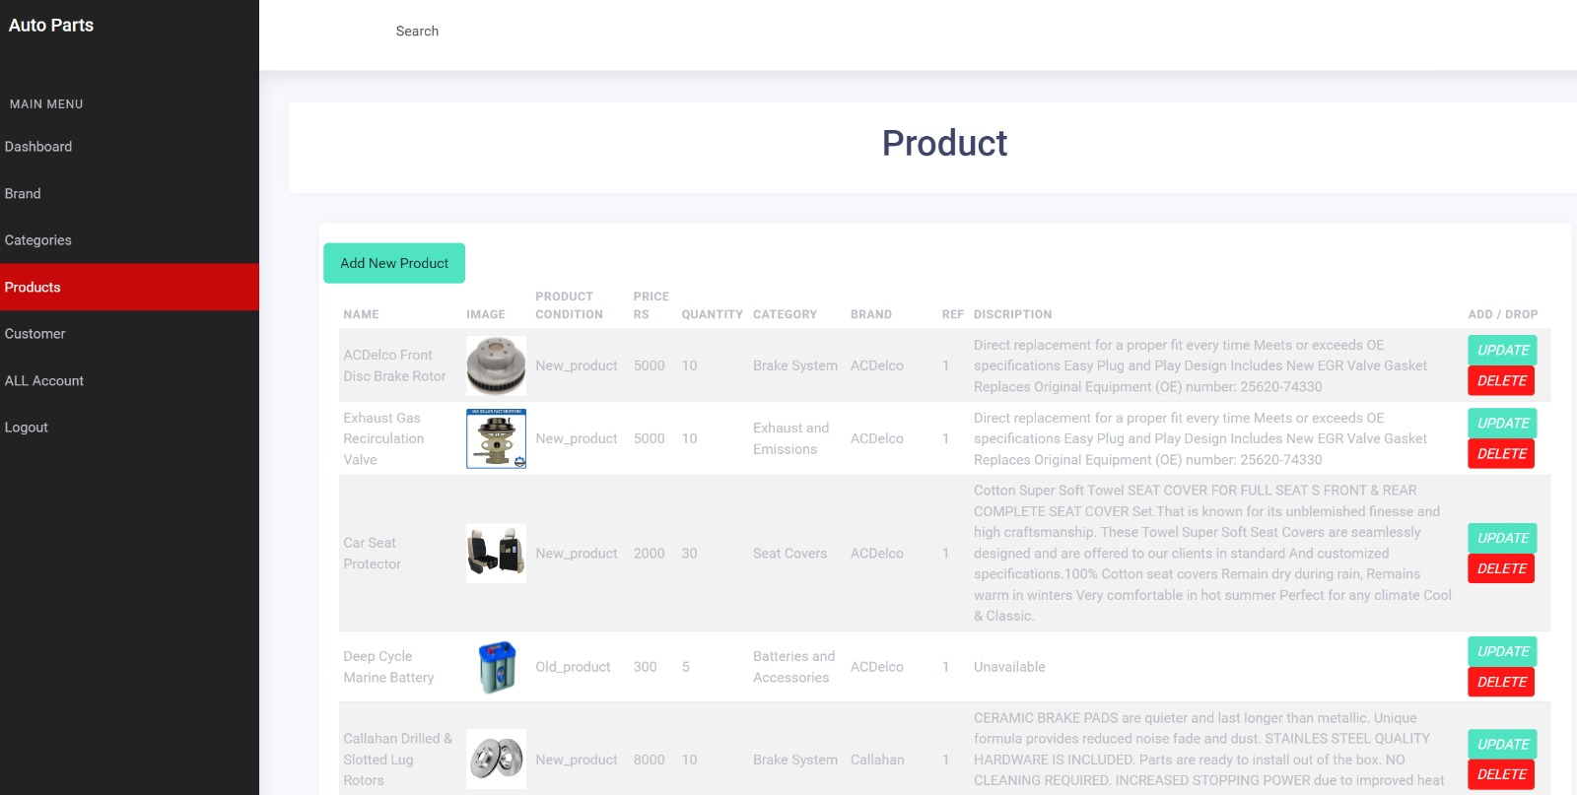
Login Page
Product Listing

Slide 25
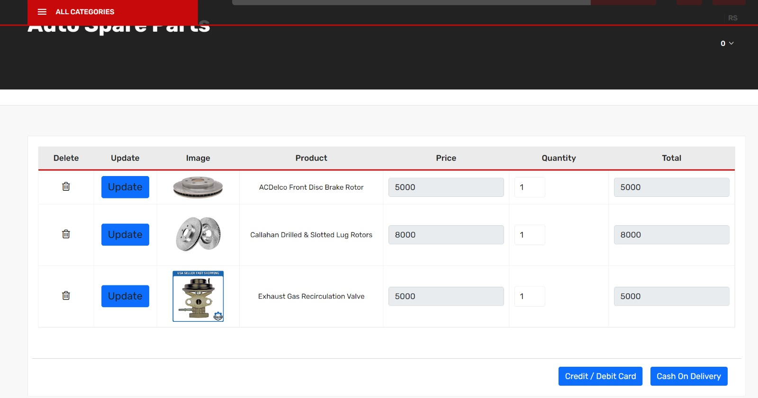
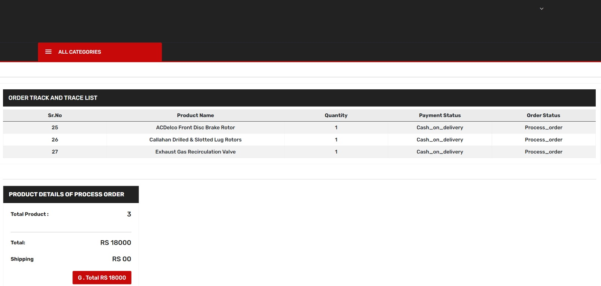
Cart Page
Review Page

Slide 26
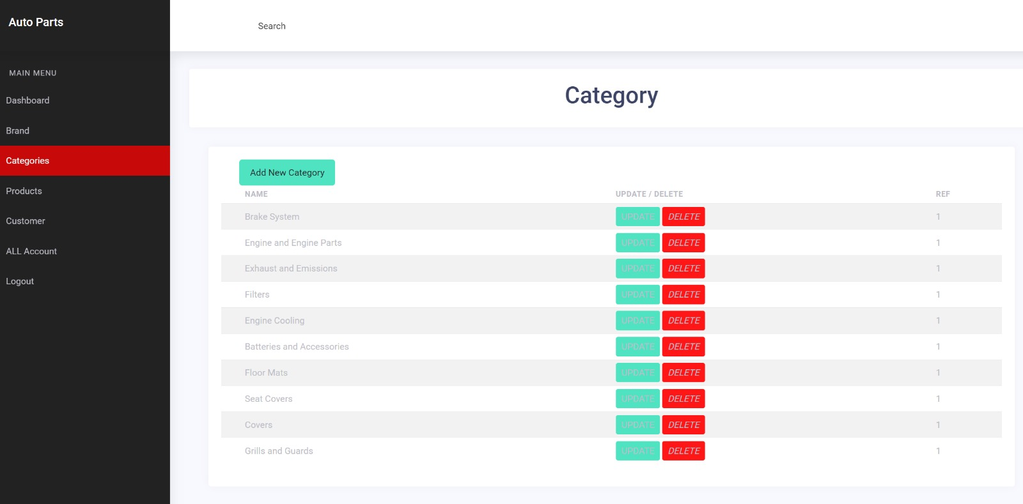
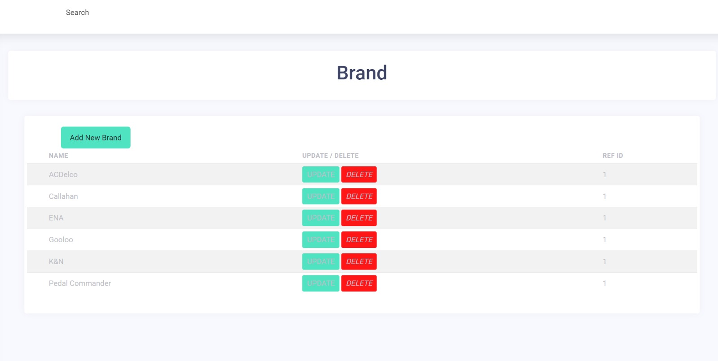
Category Addition
Brand Addition

Slide 27
Thank You

